Slide 1

Rationale
Introduction to Windows Store App Development Using HTML5 and JavaScript
Computer science is a field of study that deals with solving a variety of problems by using computers.
  To solve a given problem by using computers, you need to design an algorithm for it.
Multiple algorithms can be designed to solve a particular problem.
An algorithm that provides the maximum efficiency should be used for solving the problem.
  The efficiency of an algorithm can be improved by using an appropriate data structure.
Data structures help in creating programs that are simple, reusable, and easy to maintain.
This module will enable a learner to select and implement an appropriate data structure and algorithm to solve a given programming problem.

Slide 2
Objectives
  In this session, you will learn to:
  Access data from local databases
  Access remote data
Notes:
2

Slide 3


Demo: Accessing Data from a Local Database
  Problem Statement:
  Jake has developed a Windows Store app named Greedy Basket. The game allows a user to collect coins in a basket. The user is assigned one score point for every coin that he/she collects successfully in the basket.
  Now, Jake needs to enhance the app by storing the score obtained by the user. The information being stored contains the following fields:
    Name of the player.
    Score obtained by the player.
    The date when the game was played.

Slide 4
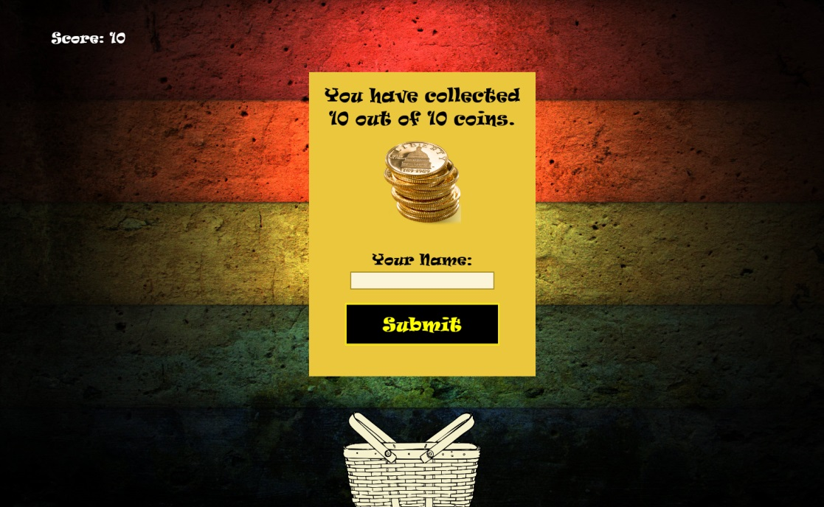
Demo: Accessing Data from a Local Database (Contd.)
  To accept the name of the player, he has decided to prompt the user to enter his/her name when the game is over. For this, he modifies the existing panel, which will be displayed when the game is over, as shown in the following figure.

Slide 5
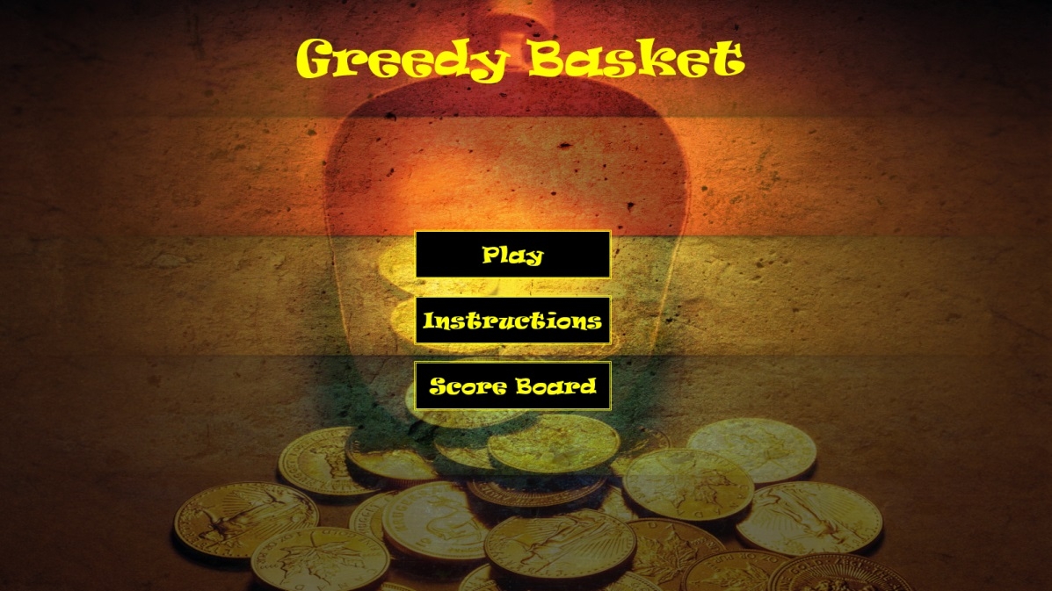
Demo: Accessing Data from a Local Database (Contd.)
  When a user clicks on the Submit button, he/she is navigated to the Home page. Now, he wants to allow the user to view the stored scores. For this, he has added another button, Score Board, on the Home page of the app, as shown in the following figure.

Slide 6
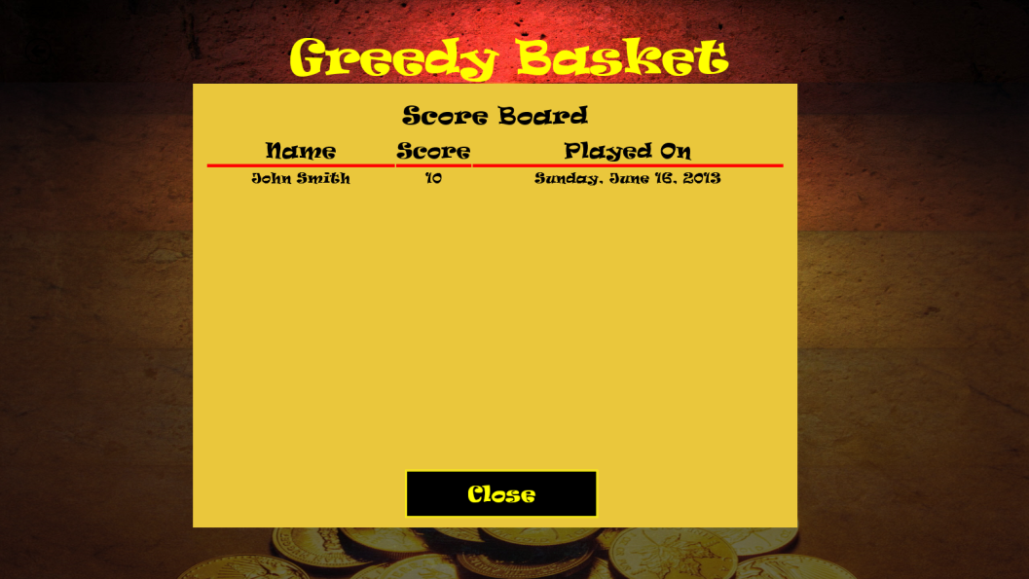
Demo: Accessing Data from a Local Database (Contd.)
  When a user clicks the Score Board button, the user should be navigated to the Score Board page. The Score Board page displays the saved scores in a format, as shown in the following figure.
  Help Jake in Implementing the preceding functionality in the app.

Slide 7
Demo: Accessing Data from a Local Database (Contd.)
  Solution:
  To implement the required functionality, Jake needs to perform the following tasks:
    1. Open a database.
    2. Save player score.
    3. Create the Score Board page.
    4. Display the Score Board page.
    5. Execute the app and verify the output.

Slide 8
Accessing Remote Data
  Apps may need to use external data to perform certain operations.
  This data can be accessed from remote locations from the Web or from the cloud through various means.
Notes:
8

Slide 9
Accessing Data Through XMLHttpRequest
  When an app needs to access remote data from the cloud, it needs to:
  Use the HTTP requests to send data.
  Use the HTTP responses to receive data.
  For this, you can use the XMLHttpRequest object provided in JavaScript.
  An XMLHttpRequest object:
  Can be used to exchange data with a server while consuming a Web service.
  Establishes a connection between the app and the cloud and then sends and receives data.
  Maintains a session for the HTTP requests and responses in isolation from the other XMLHttpRequest connections.
Notes:
9

Slide 10
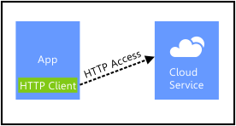
Accessing Data Through XMLHttpRequest (Contd.)
  The following figure shows the working of the XMLHttpRequest object with an app.
Notes:
10

Slide 11
Accessing Data Through XMLHttpRequest (Contd.)
  To access data through XMLHttpRequest:
  Identify a website that provides a Web service.
  Identify the API of the Web service that you want to use for accessing data.
  Sign up with the identified website.
  Get the Unique Access Code (UAC) and the REQUEST URL.
  Add request parameters to the base URL.
  Retrieve the response by using the URL.
  Parse the response and display data.
Notes:
11

Slide 12
Accessing Data Through XMLHttpRequest (Contd.)
Let us look at an example, which retrieves weather information through XMLHttpRequest

Slide 13
Accessing RESTful Web Services
  REST:
  Is an acronym for Representational State Transfer.
  Is a lightweight, stateless protocol used for developing networked applications.
  Uses simple HTTP to make calls between machines.
  Apps that use REST for accessing remote data do not need to be heavily coded.
  The following code snippet shows a request to retrieve weather information using the REST protocol:
  http://i.wxbug.net/REST/Direct/GetForecastHourly.ashx?zip=21044&ht=t&ht=i&
  ht=d&api_key= fwSir6l
Notes:
13

Slide 14
Accessing RESTful Web Services (Contd.)
  You can invoke a REST service by using the WinJS.xhr() function, as shown in the following code snippet:
  WinJS.xhr({type: "GET", url: " http://i.wxbug.net/REST/Direct/GetForecastHourly.ashx?zip=21044&ht=t&ht=i&
  ht=d&api_key= u2xxq4he7g24nvjppkqqe6em", responseType: "json" }).done();
Notes:
14

Slide 15
Accessing RESTful Web Services (Contd.)
  Simple Object Access Protocol (SOAP) requires you to write huge amount of code to access data from remote locations.
  The following example shows a request to retrieve weather information using SOAP:
  <?xml version="1.0"?>
  <s11:Envelope xmlns:s11="http://schemas.xmlsoap.org/soap/envelope/">
  <s11:Body>
  <ns1:GetCityWeatherByZIP xmlns:ns1="http://ws.cdyne.com/WeatherWS/">
  <ns1:ZIP>22313</ns1:ZIP>
  </ns1:GetCityWeatherByZIP>
  </s11:Body>
  </s11:Envelope>
Notes:
15

Slide 16
Bidirectional Communication Using WebSockets
  The WebSocket protocol:
  Is an advanced technology that opens a communication session between the app and a Web server.
  Sends messages to the server and receive responses based on specific events in real time.
Notes:
16

Slide 17
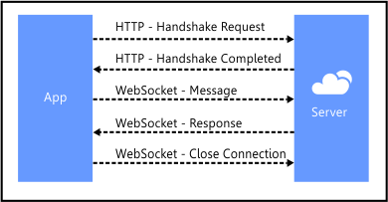
Bidirectional Communication Using WebSockets (Contd.)
  To establish a WebSocket connection for a Windows Store app, you need to perform a handshake between the client and server.
  The handshake is performed using an HTTP request that is exchanged between the client and server.
  The following figure shows the process of working with a WebSocket in an app.
Notes:
17

Slide 18
Summary
  In this session, you learned that:
  An XMLHttpRequest object can be used to exchange data with a server while consuming a Web service.
  REST is a lightweight, stateless protocol used for developing networked applications.
  The WebSocket protocol is an advanced technology that opens a communication session between the app and a Web server.
  To establish a WebSocket connection for a Windows Store app, you need to perform a handshake between the client and server.
Notes:
18

Slide 19

Q&A

